Slide 1
Simple Movie Recommender
& Movie Topics Over Time
Metis Data Science Bootcamp
Project 4
Presented by : Xinni
Notes:
Hello everyone, I’m Xinni and today i will be presenting on my findings of movie topics over time & a simple movie recommender created using NLP Topic Modeling.

Slide 2
Why Movies?
Not many movie releases in 2020
Difficult to choose via genres alone
Use NLP Topic Modelling
Movie recommender based on its story
How topics change over time for different generations
Notes:
Many movie schedule to be release this year have been pushed backed due to the covid-19. Rather than waiting for new release, many people are looking back at the old movies to watch. Choosing a film based on its main genres only might not give us a movie we like as many films cross into multiple genres. The objective of the movie recommender is to look at the story of the flim and recommend a similar movie to us. We will use NLP Topic modelling on movies’ plot to find its content. Also we wish to find out the movie preferences of each generation over time.

Slide 3




AGENDA
03.
Topic modelling
Data preprocessing
02.
DATA
Collection
01.
06.
conclusion
TOpics over time
05.
Simple recommender
04.
Natural Language Processing & Vectorization
Data source and exploration
Which movie to watch?
Trend of the topics over time
Notes:
We will begin with understanding our data followed by our preprocessing and modelling process then our results…. Using the tools shown below.

Slide 4
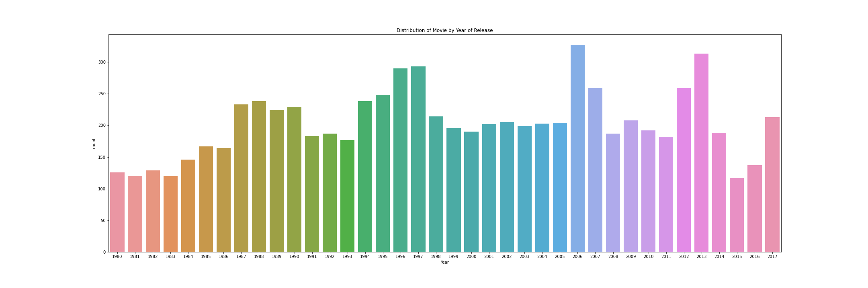
Data Set & Exploration
Kaggle : Movie plots from Wikipedia From 1901 -2017
Focus on American movies after 1980s
7700 Movies
Notes:
We got our dataset from Kaggle , a list of different countries movies from 1901 -2017 from Wikipedia. For this project, I will be focusing on American movies from 1980 to 2017 which gives us total of 7700 movies. THe graph shows distribution of the movies release each year.

Slide 5
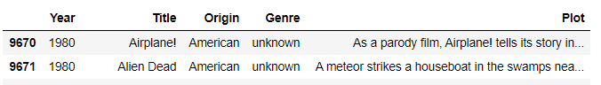
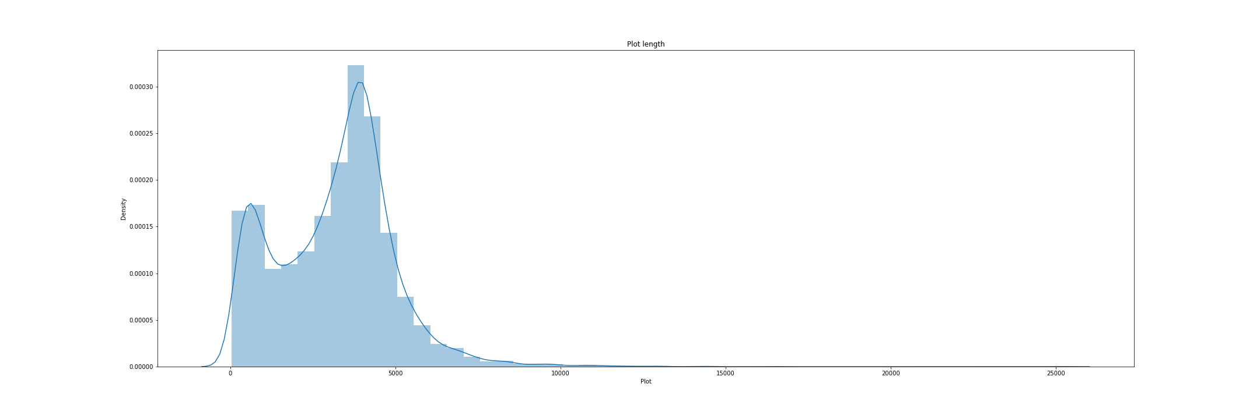
Data Set & Exploration
Most plot length are less than 5000 characters
Notes:
Here’s a sample of the clean dataset which I will be using NLP on the plot. & the distribution of the length of these plot.

Slide 6
Natural Language Processing & Vectorization
"After three years in prison, Cruella de Vil has been cured of her desire for fur coats by Dr. Pavlov”
'after', 'three', 'year', 'prison', 'cruella', 'de', 'vil', 'cure',, 'desir', 'fur', 'coat', 'dr.', 'pavlov',
Convert word collection into a matrix
2 types : Count Vectorizer & TF-IDF Vectorizer
by sentence, then by word
Reduce a word to its word stem
Remove meaningless words
Stemming
Stop words
Tokenization
Vectorization
Notes:
As shown the paragraph goes through tokenizing and stemming using NLTK & remove meaningless words to give use a collection of words. Where we can convert a collection of words to a matrix. Which I test with 2 type of vectorizer, the count vectorizer which count the no. of words and the TFIDF vectorizer which place more weight for unique words.

Slide 7
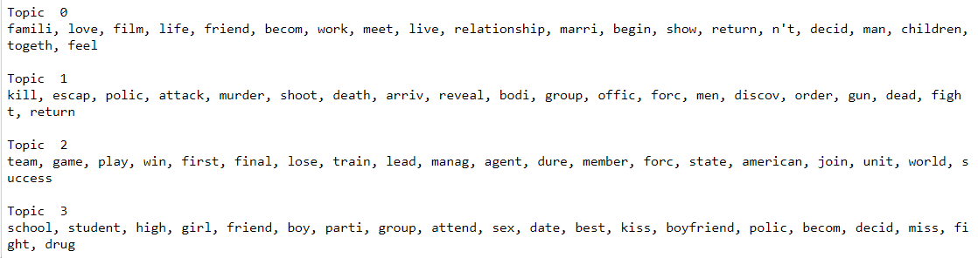
Topic Modelling
Latent Semantic Analysis (LSA)
Latent Dirichlet Allocation (LDA)
Non-Negative Matrix Factorization (NMF)
Notes:
Each matrix is then put into these 3 Topic models the LSA , LDA and NMF. These models automatically analyzes text data to determine cluster words for a set of document which discover the hidden themes in our collections of movie plots. After some testing with different no. of topics and looking at the words generated for each topic. I observe that the NMF using the TF-IDF matrix is able to gives us 4 most distinct topics - Topic 0 Relationship - family , love ,life …. Topic 1 Crime/ Hero (referring to person saving the day) kill , escape , Topic 2 Team, winning , play game, Topic 3 school life as shown.

Slide 8
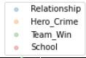
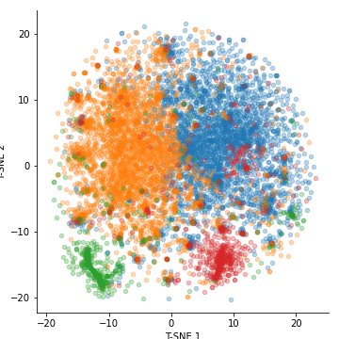
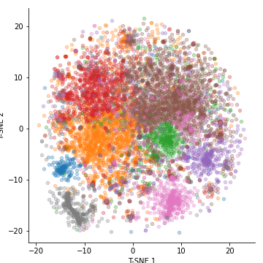
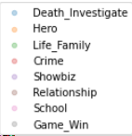
Topic Modelling
Non-Negative Matrix Factorization (NMF) with TF-IDF matrix
t-SNE dimension reduction
4 Topics
8 Topics
Notes:
To get a better visualization, i use T-SNE dimension reduction to see how these 4 topics are clustered in 2 dimensions. Notice that the area for Blue and Orange clusters are relatively larger. So we increase the no. of topics to 8 better clustering. Now we see that orange area can be further split into Hero and crime topics. Show video. We can also observe that movies similar plot are bring cluster tgt.

Slide 9
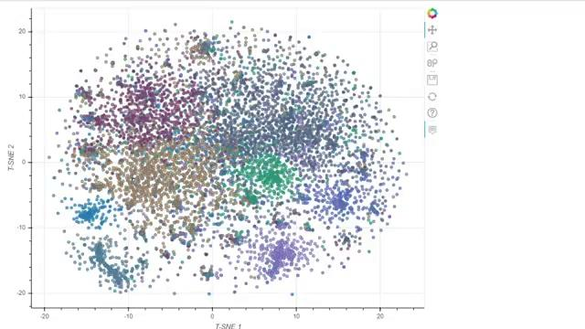
Topic modelling
Non-Negative Matrix Factorization (NMF)
t-SNE dimension reduction
4 Topics
8 Topics
Notes:
We also observe that movies similar plot are close together in this interactive graph. This is a group Family comedy theme movies and there is sci-fi end of the world movies

Slide 10
The Movie Recommender
Content-based using Cosine similarity
Input
Recommendations
'Pitch Perfect 3',
'Pitch Perfect',
'Get on Up',
'Sparkle',
'Alvin and the Chipmunks: The Squeakquel',
'Stage Fright',
'Demolition High',
'Happy Gilmore',
'The Five Heartbeats',
'Incredible Burt Wonderstone, The Incredible Burt Wonderstone'
Pitch Perfect 2
Notes:
With this understanding that movie that share similar plot are close to each other. We can create a vector representation with our TF-IDF matrix of the plot summaries. Recommender will look for other movie with the highest cosine similarity score and recommend these movies to us. Here our recommendation in the red are for my favorite movie Pitch Perfect 2.

Slide 11
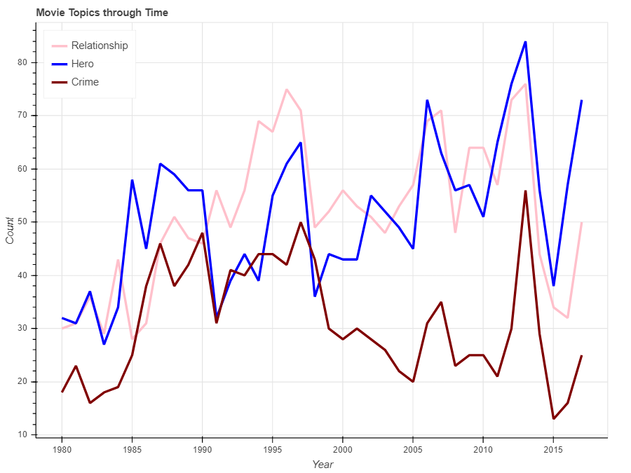
Notes:
The Movie topics though time could show the different preferences in different age group. The main topics that consumer prefers are Relationship, Hero ,Crime topics, we can see how moviegoer’s taste have evolved over time. In 1985 heroes movie was popular until 1990 then

Slide 12
Notes:
then there was an emphasis change to relationship topics.

Slide 13
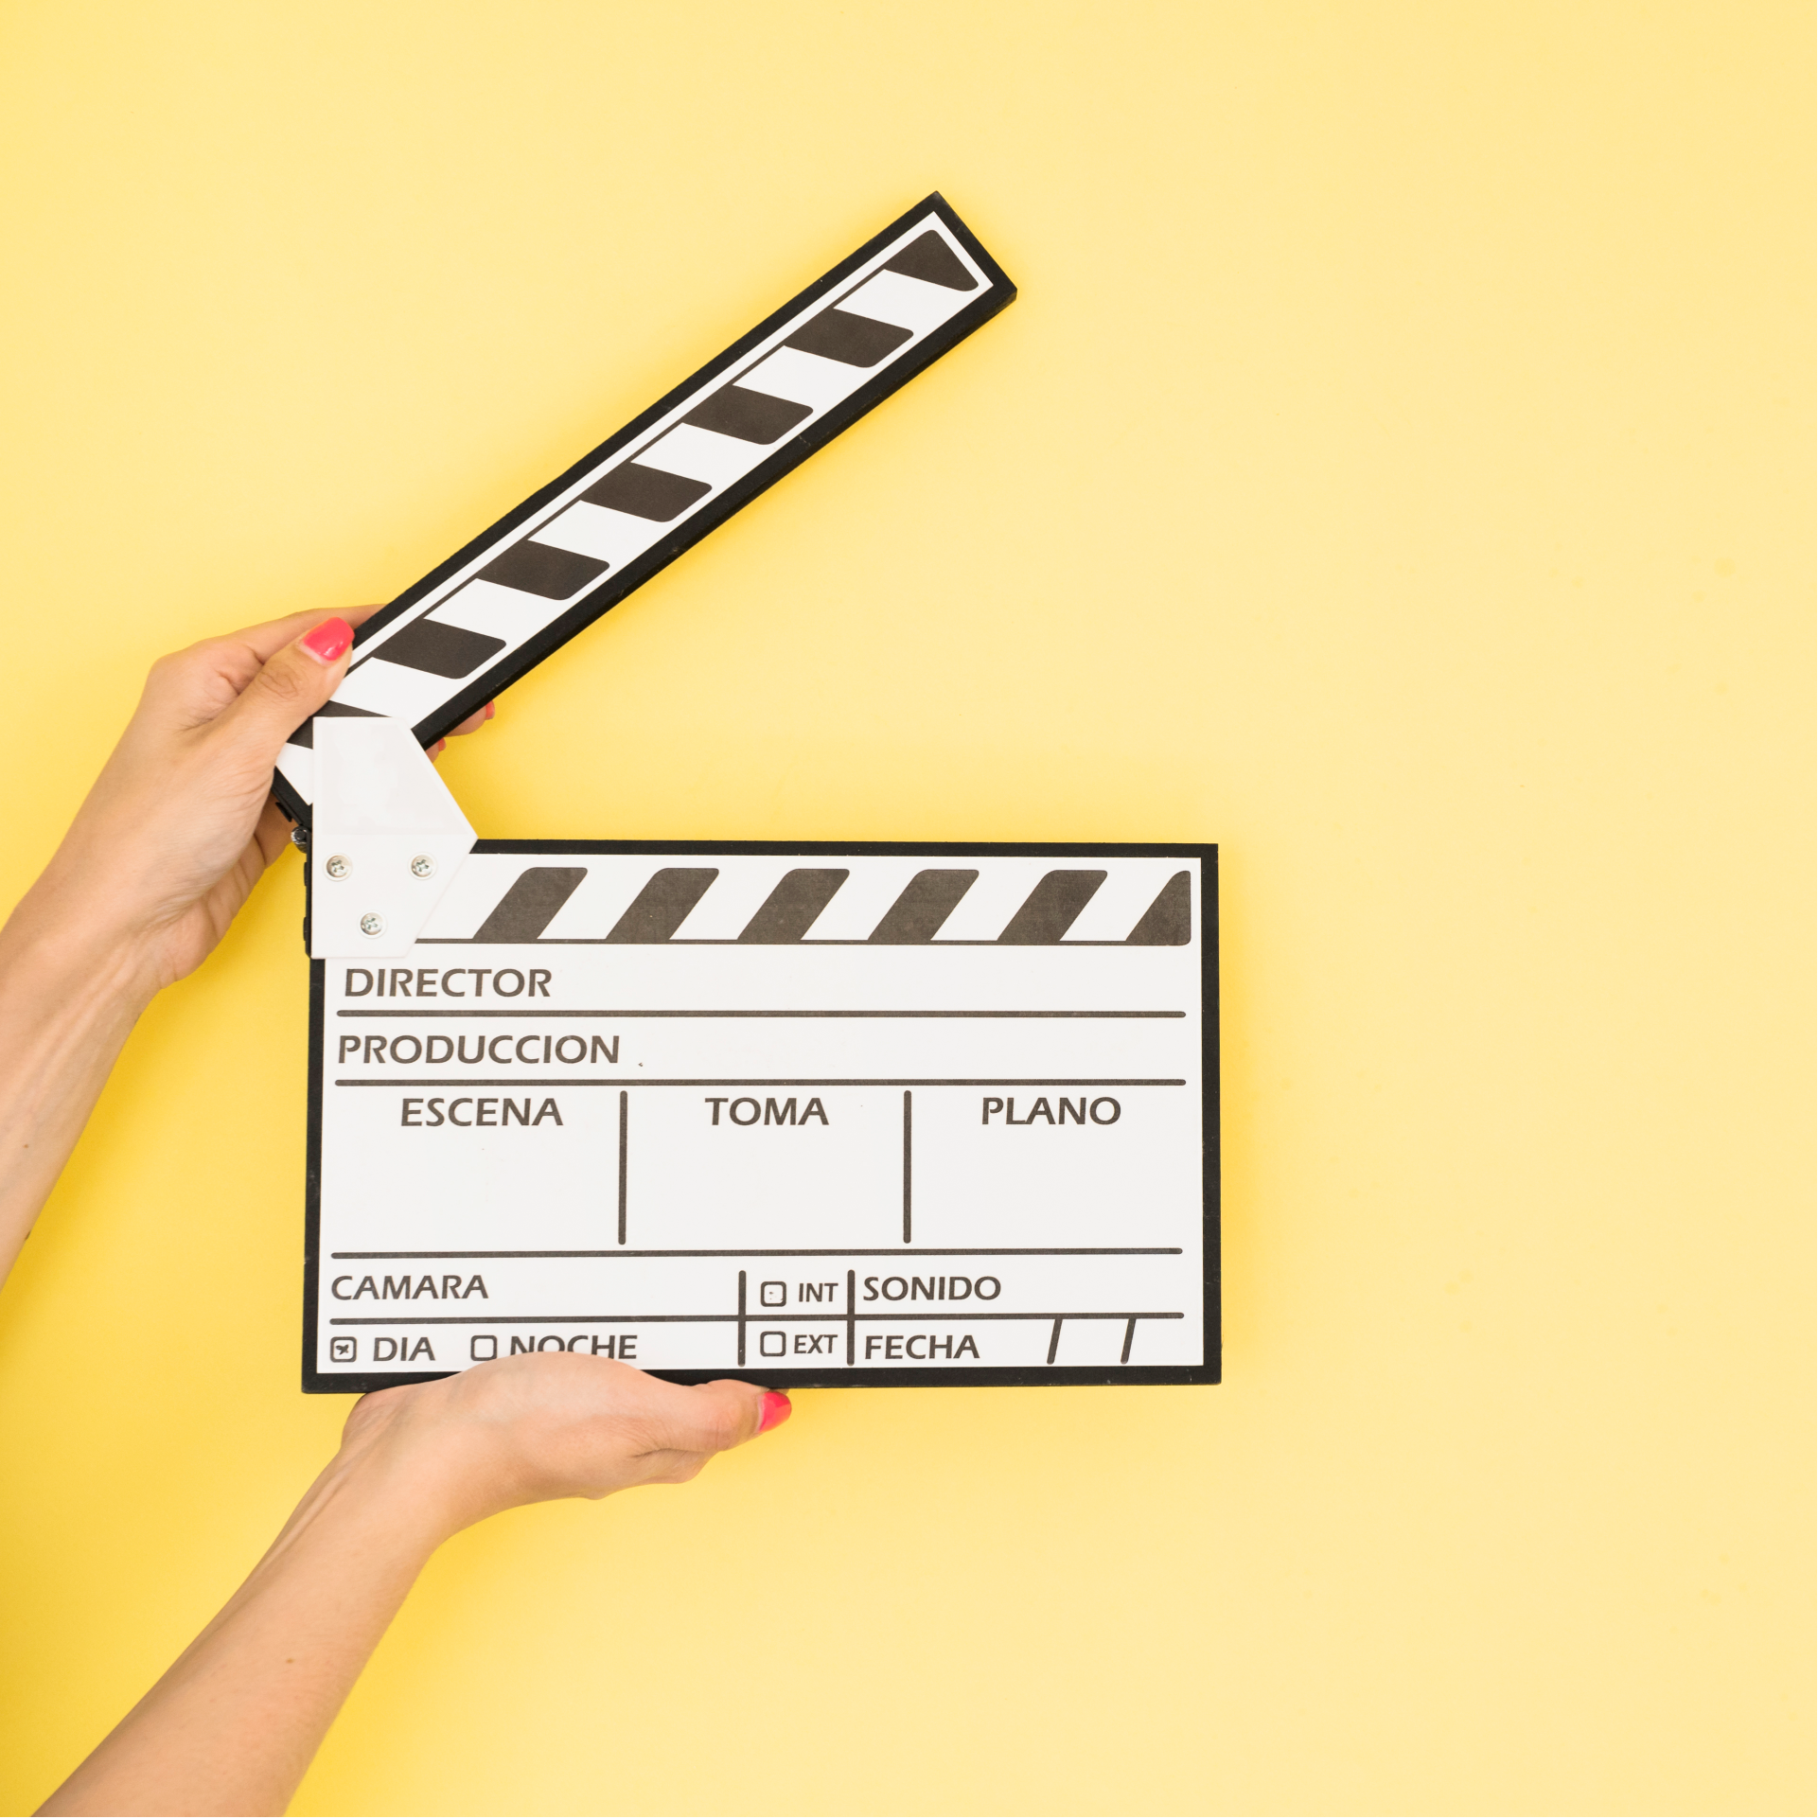
Conclusion and Future Works
Topics revolve around
Relationship
Hero
Reduce lengthy plot
Deployment to Heroku
Collaborative filtering engines
Collect User’s data
Notes:
In conclusion, most movies revolve around topics on relationship and a hero which saves the day.
With more time we can deploy our recommender to Heroku
We can also make a more personalised recommender by collecting User data to enhance our recommender.

Slide 14
THANKS!
Do you have any questions?
Let’s connect via
Xinni
sabrinalixinni@hotmail.com
Please keep this slide for attribution.

